Slide 1



Padlet Link:
Password:
PHY2004
Socrative Link:
https://api.socrative.com/rc/5fvfh7

Slide 2

PHY2004: Electromagnetism and Optics
Lecture 14:
Boundary conditions and the dispersion relation
Dr. Charlotte Palmer/Prof. Gianluca Sarri

Slide 3
Objectives
Boundary conditions of Maxwell’s equations for dielectric
Waves in conductors
Complex refractive index
Dispersion relation
Wave-packets - Group velocity and phase velocity
Anomalous dispersion
Dr. Charlotte Palmer/Prof. Gianluca Sarri

Slide 4
Boundary conditions
When light hits an interface a portion of the light is reflected and some is transmitted.
We know that the speed of light is altered in a medium. The frequency of the light must remain unchanged to conserve energy, therefore the wavelength shifts.
So, at the interface between media we have a change in our wave. This has to satisfy certain conditions – the boundary conditions.
The boundary conditions for a dielectric can be determined using Maxwell’s equations.
Dr. Charlotte Palmer/Prof. Gianluca Sarri

Slide 5
Boundary conditions for Electric field normal to surface
Gauss’ law for electric fields:
Electric/Displacement field decomposed into components parallel with and perpendicular to the interface
E_{v1}
E₁
perpendicular
Replacing displacement field with electric field (assuming a linear medium).
E_{h1}
parallel
Conditions in medium 1:
𝜀₁, 𝜇₁, n₁
Area, A
Gaussian volume
Flux through cylinder sides reduces to zero as cylinder height is reduced
height, h
interface
Conditions in medium 2:
𝜀₂, 𝜇₂, n₂
As the cylinder is compressed, the integral of enclosed charge density only includes charges at the surface within area, A.
E_{v2}
E₂
perpendicular
surface charge density
E_{h2}
parallel
Dr. Charlotte Palmer/Prof. Gianluca Sarri

Slide 6
Socrative 1:
What would happen to this equation if we were looking at the interface between dielectric materials?
The permittivities would be equal would be equal
The electric fields would be equal
There would be no surface charges
Don’t know
Dr. Charlotte Palmer/Prof. Gianluca Sarri

Slide 7
Boundary conditions for Electric field normal to surface
In a perfect dielectric we have no free charges so we can simplify this expression to:
In a perfect conductor, there are no electric fields as the free charges can rapidly move to damp the fields:
Dr. Charlotte Palmer/Prof. Gianluca Sarri

Slide 8
Socrative 2:
Based on our use of Gauss’ law for electric fields in determining the boundary condition for the electric field perpendicular to the surface, which of Maxell’s laws do you think we should use for the electric field parallel to the interface?
Gauss’ law for electric fields
Gauss’ law for magnetic fields
Faraday’s law
Ampere’s law
Don’t know
Dr. Charlotte Palmer/Prof. Gianluca Sarri

Slide 9
Boundary conditions for Electric field parallel to surface
Faraday’s law:
Line integral along vertical sides
E_{v1}
E₁
perpendicular
E_{h1}
parallel
Conditions in medium 1:
𝜀₁, 𝜇₁, n₁
Reduce the height of the loop to zero so the flux through the loop is also zero.
length, l
Closed loop
interface
height, h
Conditions in medium 2:
𝜀₂, 𝜇₂, n₂
The electric field parallel with the interface is equal in both media.
We’ve made no assumptions so this is valid for dielectrics and conductors.
E_{v2}
E₂
perpendicular
E_{h2}
parallel
Dr. Charlotte Palmer/Prof. Gianluca Sarri

Slide 10
Boundary conditions for Magnetic field normal to surface
Gauss’ law for magnetic fields:
Electric field decomposed into components parallel with and perpendicular to the interface
B_{v1}
B₁
perpendicular
B_{h1}
parallel
Flux through cylinder sides
Conditions in medium 1:
𝜀₁, 𝜇₁, n₁
Area, A
Gaussian volume
interface
Reduce the height of the cylinder to zero so now there’s no flux going through the side.
Conditions in medium 2:
𝜀₂, 𝜇₂, n₂
B_{v2}
B₂
perpendicular
The amplitude of the magnetic field perpendicular to the interface is equal in both media. Again, no dependence on material properties so this is the same in all media.
B_{h2}
parallel
Dr. Charlotte Palmer/Prof. Gianluca Sarri

Slide 11
Boundary conditions for Magnetic field parallel to surface
Rate of change of electric flux through surface
Ampere’s law:
B_{v1}
B₁
perpendicular
Total enclosed current
B_{h1}
parallel
Conditions in medium 1:
𝜀₁, 𝜇₁, n₁
length, l
Integrate and reduce the height of the loop to zero so the integral along the height is zero and so is the electric flux through the surface.
Closed loop
interface
height, h
Conditions in medium 2:
𝜀₂, 𝜇₂, n₂
Surface current density (line density)
B_{v2}
B₂
perpendicular
B_{h2}
parallel
Dr. Charlotte Palmer/Prof. Gianluca Sarri

Slide 12
Boundary conditions for Electric field normal to surface
In a perfect dielectric we have no free currents so we can simplify this expression to:
In a non-magnetic material :
We know from Lenz’s law that changing magnetic fields induce a current which acts to oppose the change so will act to cancel an oscillating field so we can say that good conductors will tend to exclude magnetic fields and we can write:
Dr. Charlotte Palmer/Prof. Gianluca Sarri

Slide 13
Thought break:
What is the electric field inside a conductor? Any why?
Dr. Charlotte Palmer/Prof. Gianluca Sarri
Notes:
https://api.socrative.com/rc/5fvfh7

Slide 14
Skin depth
From the boundary conditions we’ve seen that the electric field across the boundary is given by:
For a perfect conductor, we know that the surface charges can rearrange to compensate the incident electric field and that the electric field within the conductor is zero.
But in reality the charge density is limited and the damping of the fields is not instantaneous. The electric and magnetic fields can penetrate into the conductor by a distance called the skin depth.
Skin depth
Conductivity
Dr. Charlotte Palmer/Prof. Gianluca Sarri

Slide 15
Waves in media with non-zero conductivity
To derive an expression for the skin depth, we’ll go back to our derivation of the wave equation where we found:
Having made the assumption of no external charges, and that we have a simple Ohmic conductor where:
Conductivity
We can substitute the same simple plane wave solution into this more general wave equation to see what we get:
Simple plane wave travelling in z-direction
Dispersion relation:
For a dielectric, where we had zero conductivity, the dispersion relation was:
Dr. Charlotte Palmer/Prof. Gianluca Sarri

Slide 16
The dispersion relation
In comparison to the dielectric dispersion equation, this is a little more complex (literally).
Imaginary number
If we assume a simple form for the complex wavevector:
we can use this to determine the real and imaginary component using the dispersion relation.
TRY THIS
Note again that if conductivity is zero, then 𝛽 will be zero and 𝛼 will be significantly simplified and our dispersion relation will return to the dielectric case.
Real exponential decay in wave amplitude along z
Dr. Charlotte Palmer/Prof. Gianluca Sarri

Slide 17
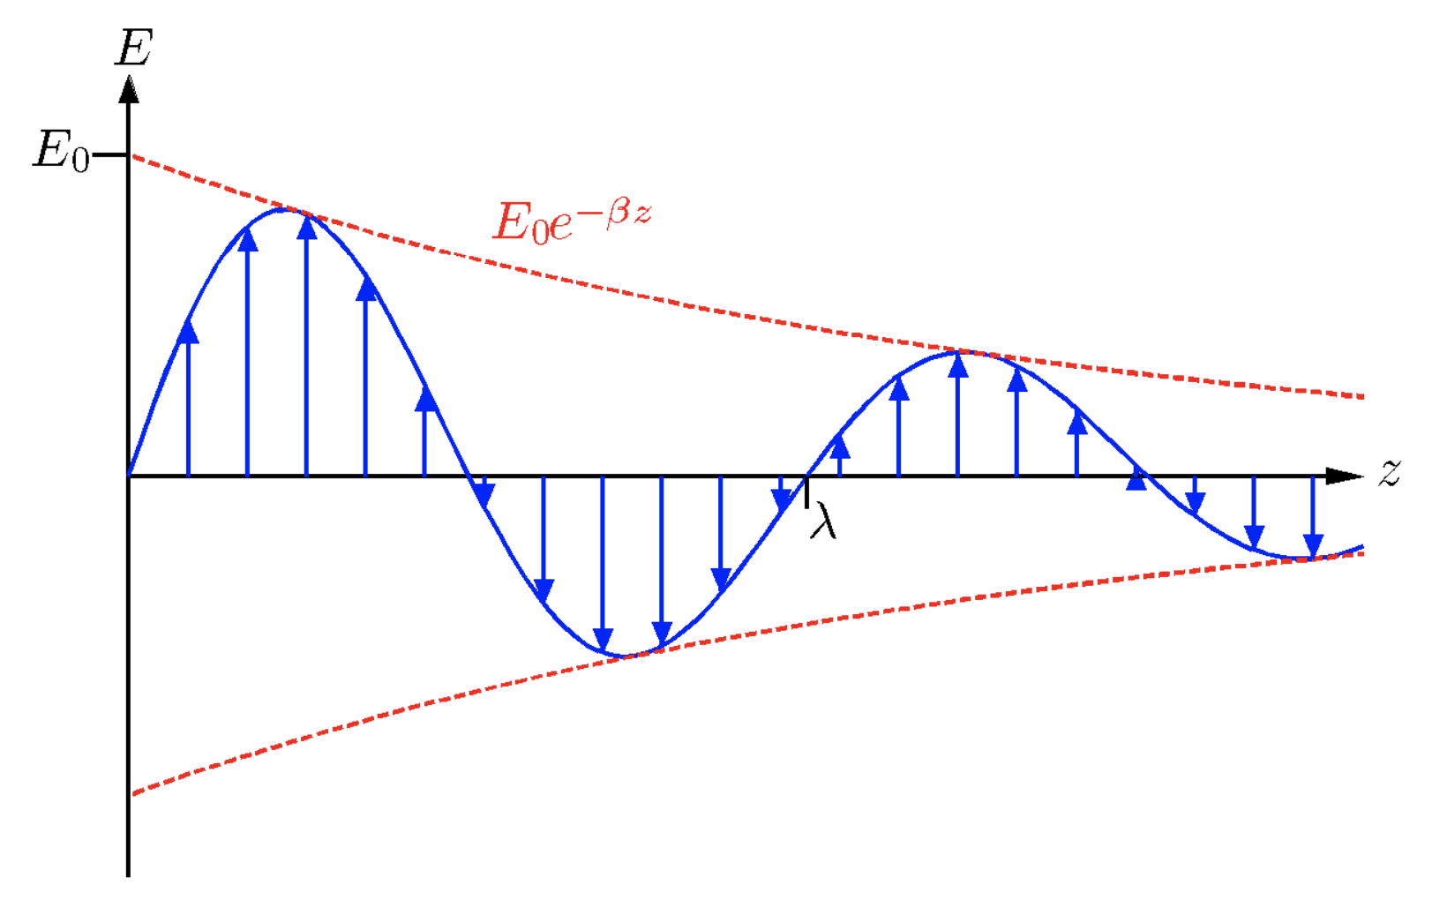
Exponentially decaying wave
This actual fields are given by the real component on the equation and so here we have both the cosine oscillating field with amplitude E₀ and a real exponential decay.
From Uni. Liverpool – Advanced EM
The distance over which this wave decays to 1/e of the original amplitude is the skin depth.
The reason for the decay is energy loss from the electromagnetic wave to the material as it drives currents which heat the material.
Try to demonstrate how you can obtain the skin depth from the electric field above
Dr. Charlotte Palmer/Prof. Gianluca Sarri

Slide 18
Phase differences in conducting media
The decaying electric field is still varying with time and so we need to consider our accompanying magnetic field.
We do this by combining the plane wave solution with the Maxwell-Faraday law:
This is the same as for a dielectric but now k is complex written as or
We can determine see that phase difference by substituting in the plane wave solutions for E and B with an arbitrary phase difference in the magnetic field.
From this you can see that the complex wave vector introduces a phase shift in the magnetic field that is related to the ratio of the real and imaginary components of wave vector.
Dr. Charlotte Palmer/Prof. Gianluca Sarri

Slide 19
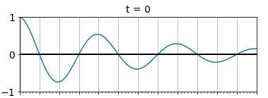
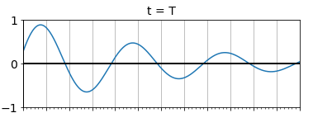
Phase velocity
The wave takes the form:
Phase of our oscillating wave
Decay due to imaginary wave vector
To determine the phase velocity we need to pick a fixed point on the wave and see how it moves with time. For a fixed phase point is constant.
Our fixed point is moving so position of the point z depends on t
Velocity of the point (phase velocity) is given by
If conductivity is zero, will reduce to
This returns us to the phase velocity of a dielectric which is independent of wave frequency (except for the dependence of permittivity and permeability on 𝜔):
Dr. Charlotte Palmer/Prof. Gianluca Sarri

Slide 20
Complex refractive index
We’ve approached this from the point of view of the complex wave vector, but it’s also possible to phrase this in terms of a complex refractive index.
The refractive index is the ratio of the phase velocity of light in a vacuum to the phase velocity of light in the medium.
If k is complex then we can represent this using a complex refractive index:
Substituting this into our plane wave:
Temporal oscillation
Exponential decay due to absorption of energy
Spatial oscillation
We end up with the imaginary component of the complex refractive index leading to a very real exponential decay in wave amplitude.
Dr. Charlotte Palmer/Prof. Gianluca Sarri

Slide 21
Dispersion
Phase velocity of a wave:
Dielectric:
Phase velocity has an additional square root dependence on angular frequency
Conductor:
The dependence of the phase velocity of the wave on the angular frequency of the wave means that waves with different frequencies (colours or energies):
propagate at different speeds through the same medium.
Have different refractive indices so they are refracted by different angles.
The dispersion of different frequencies of light gives the dispersion relation its name.
Dr. Charlotte Palmer/Prof. Gianluca Sarri

